Slide 1

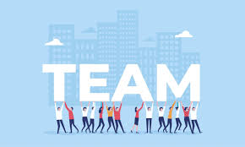
BUSINESS COMMUNICATION AND ETHICS
DEPARTMENT OF COMPUTER ENGINEERING
A Project Presentation On –
TEAM BUILDING AND SUCCESS

Slide 2

TEAM BUILDING AND SUCCESS
SUPERVISED BY: DR. JOSEPH RODRIGUES
DEPARTMENT OF HUMANITIES AND SCIENCE
Prepared By :
Hardik Prajapati 9152
Sahil Purohit 9153
Pranil Rego 9155
Reyhaan Binny 9156
Christopher Roach 9157
Alisha Rawat 9154

Slide 3
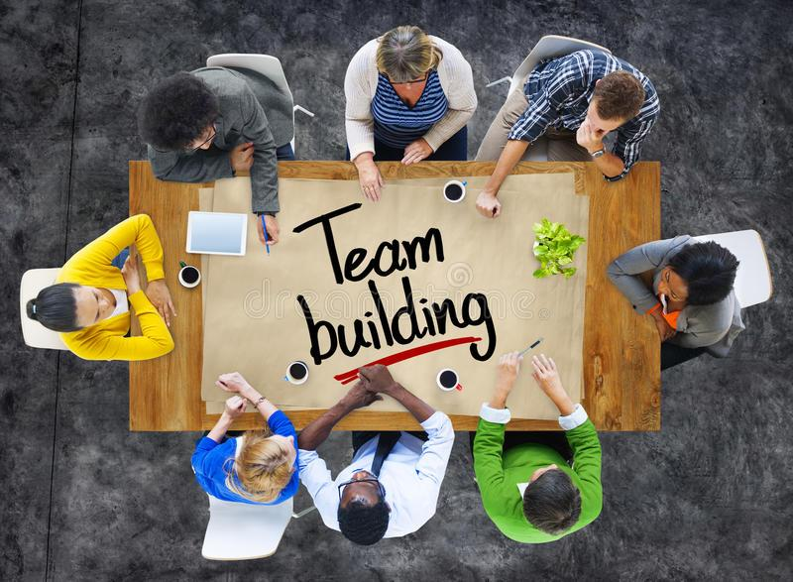
INTRODUCTION
Team Building is an action or a process in which a group of people come together and work as a team to achieve certain tasks or certain goals, which in turn increases motivation and promotes cooperation among the people.
The individual members in a team must:
Understand
Respect each other's differences
Respect their way of conduct
Thus creating a stronger bond among the individual members of the group.
Henry Ford rightly says, ‘Coming together is a beginning, staying together is progress, and working together is success.’

Slide 4
IMPORTANCE OF TEAM BUILDING
Big things can’t be completed by a single person
Planning of Complex task
Team work helps you to keep yourself in Pace & Positivity
Each person can bring their 100% to the table
Need of Different thoughts
Advantages of policy
The productivity increases in “Split and Work”
You got to Cultivate new skills from colleagues
Individual Growth and Guidance
People’s connections
Guidance and support

Slide 5

HOW DOES TEAM BUILDING LEAD TO SUCCESS
Team Building :
Improves High Performance
Improves Communication
Motivates Employess
Helps in Organisational Development

Slide 6
There are 5 Critical Factors :
Team Leadership
Shared Vision
Team Collaboration
Attitudes and Commitment
Mutual Trust

Slide 7
TIPS TO BUILD A SUCCESSFUL TEAM
Consider Each and Every thought
Keep a balance between Effusiveness and Workspace
Bonding between members
How it can cause problems
Every brain should Adapt and Learn from their surroundings
One Team & One Goal policy
Equality speaks more than Especiality

Slide 8
ELEMENTS OF A SUCCESSFUL TEAM
Goals
Goals help to bring the team together and give a common objective and purpose.
Roles
Roles make it possible for everyone on the team to have an opportunity to contribute towards the working of the final goal.
Interpersonal Relationships
Interpersonal Relationships among the members helps to create trust, collaboration and connection among them.
Processes and Procedures
Processes and procedures are the rules which help to govern the behaviour, the various expectations that may arise and the consequences of every action when standards are not met.

Slide 9







Slide 10
Google is an American multinational technology company that focuses on search engine technology, online advertising, cloud computing, etc…
Project Aristotle and its 5 key pillars:
➢ Psychological safety
➢ Dependability
➢ Structure and Clarity
➢ Meaning
➢ Impact

Slide 11

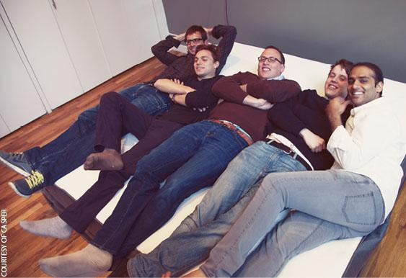
Casper is an online mattress startup that launched in 2014 and quickly became a social media phenomenon.
Casper was founded by five people - Philip Krim, Neil Parikh, T. Luke Sherwin, Gabriel Flateman and Jeff Chapin each from a different walk of life but with the same ambition to make the quality of sleep better.
Casper is the perfect example of success due to effective team building as every co-founder had a role of his own in the formation and development of the company.

Slide 12
Founded in 1997, Netflix has grown from a DVD rental business to the world’s most popular streaming service.
Key values of Netflix according to Nathan Towery, Director of Product Data Engineering & Analytics Netflix:
Judgement
Communication
Impact
Curiosity
Innovation
Courage
Passion
Honesty
Selflessness

Slide 13
Enron Corporation was an American energy, commodities and services company based in Houston, Texas.
Enron is a classic example of a company that failed to keep up to its core values.
Enron as an organization had core values as stated below:
Communication
Respect
Integrity
Excellence
However poor management and coordination lead to its downfall.

Slide 14
The Los Angeles Lakers are an American professional basketball team based in Los Angeles.
After the LA Lakers won three straight NBA championships from 2000–2002, the two uncompromising, type-A players (Shaquille O’Neal and Kobe Bryant) were paired up—and the team was never the same. This was because the two never hit it off.
A team simply can’t thrive in an environment of contention, frustration, selfishness, and uncertainty. It’s still possible to turn a team like this around, but only if cooperation, teamwork, and true leadership become the team’s true values once again.

Slide 15

Survey on Team Building

Slide 16
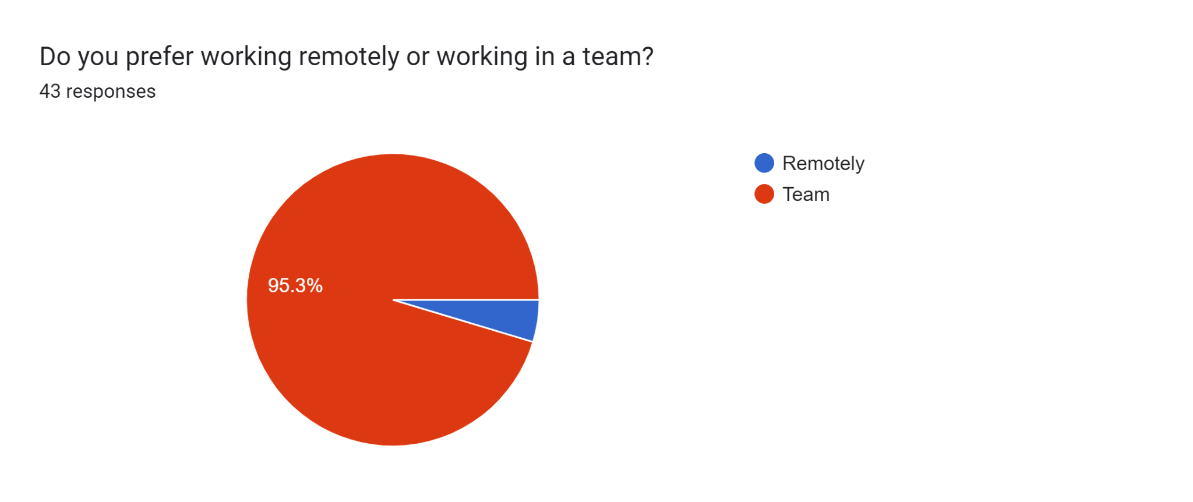

Slide 17
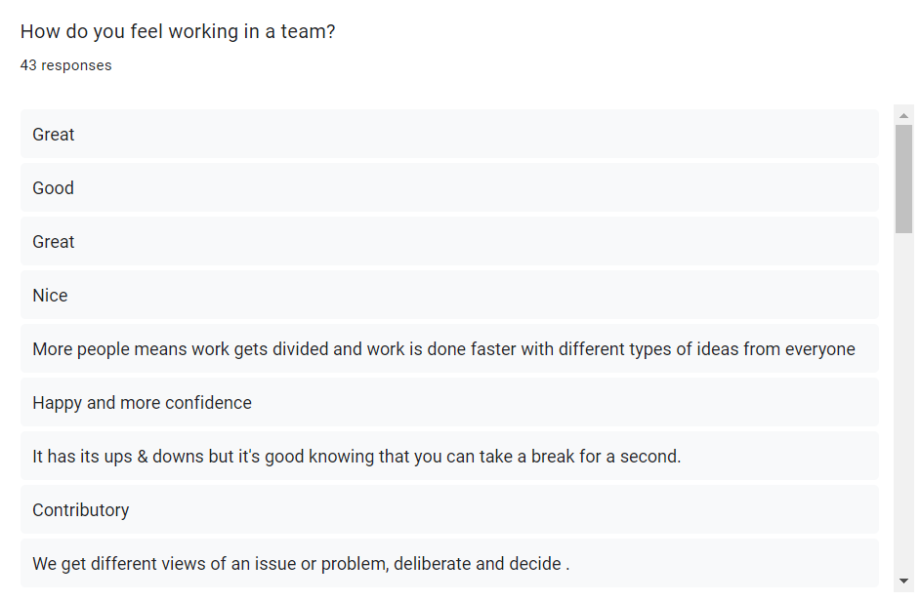

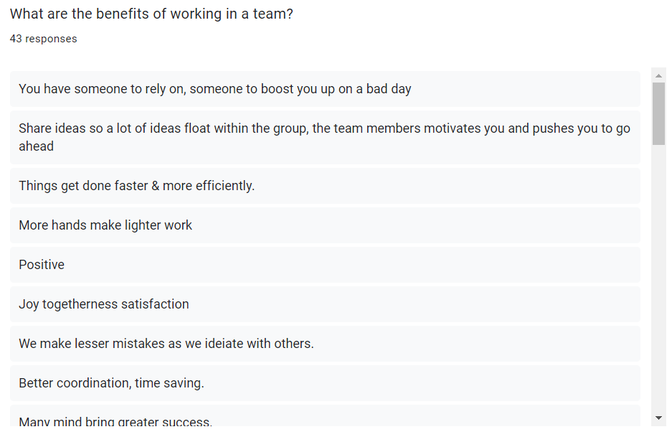
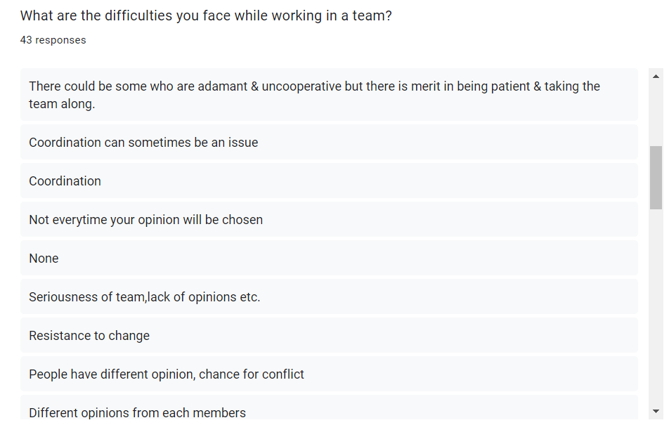

Slide 18
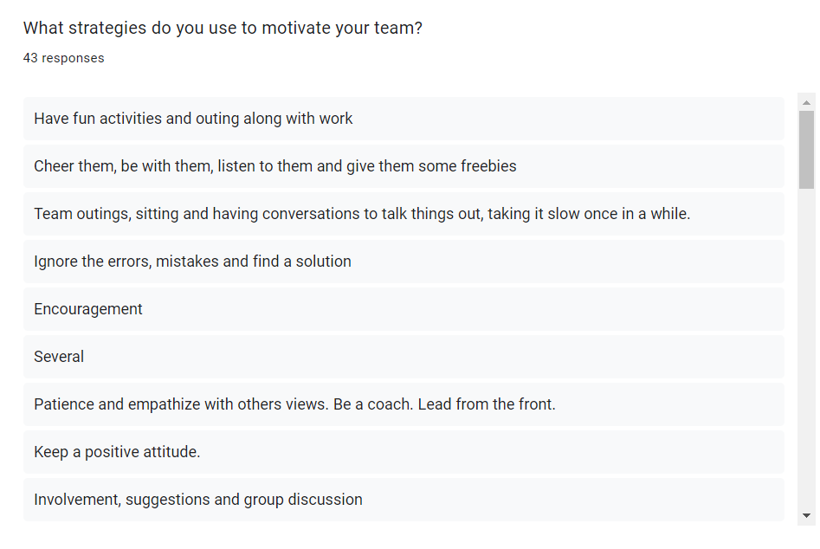
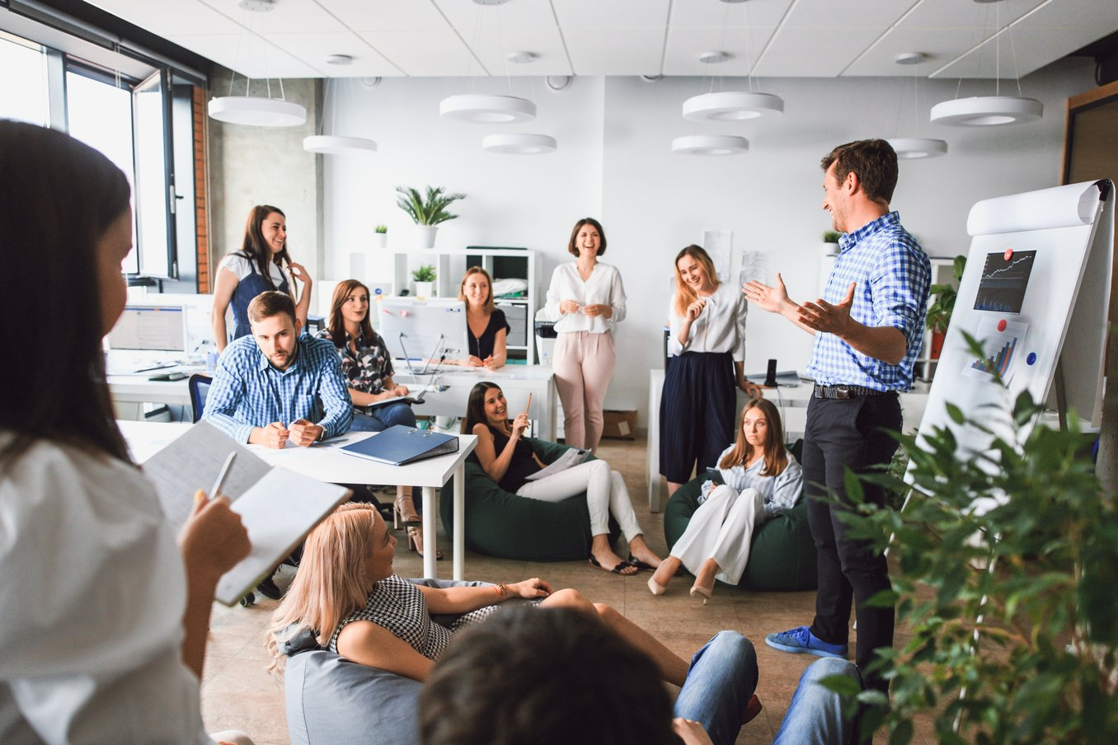
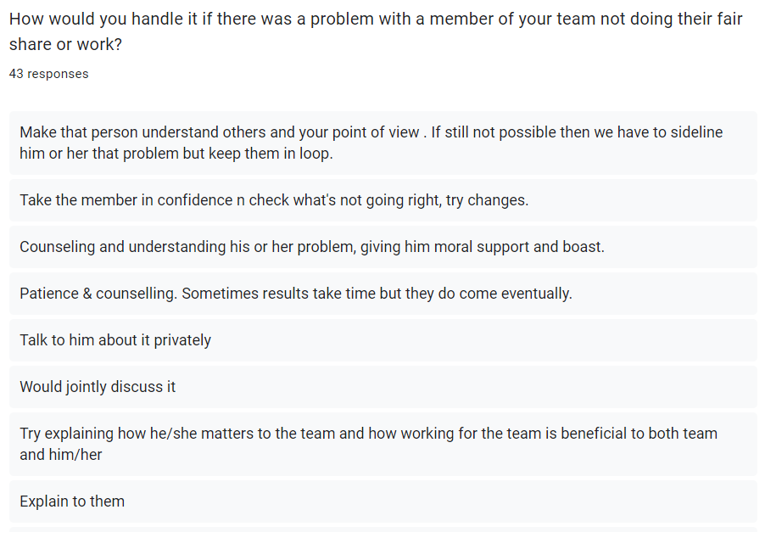
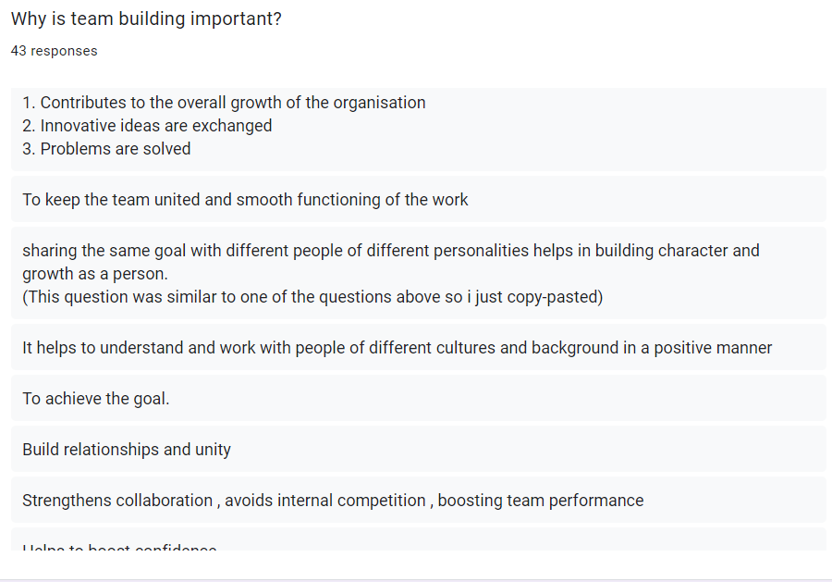

Slide 19
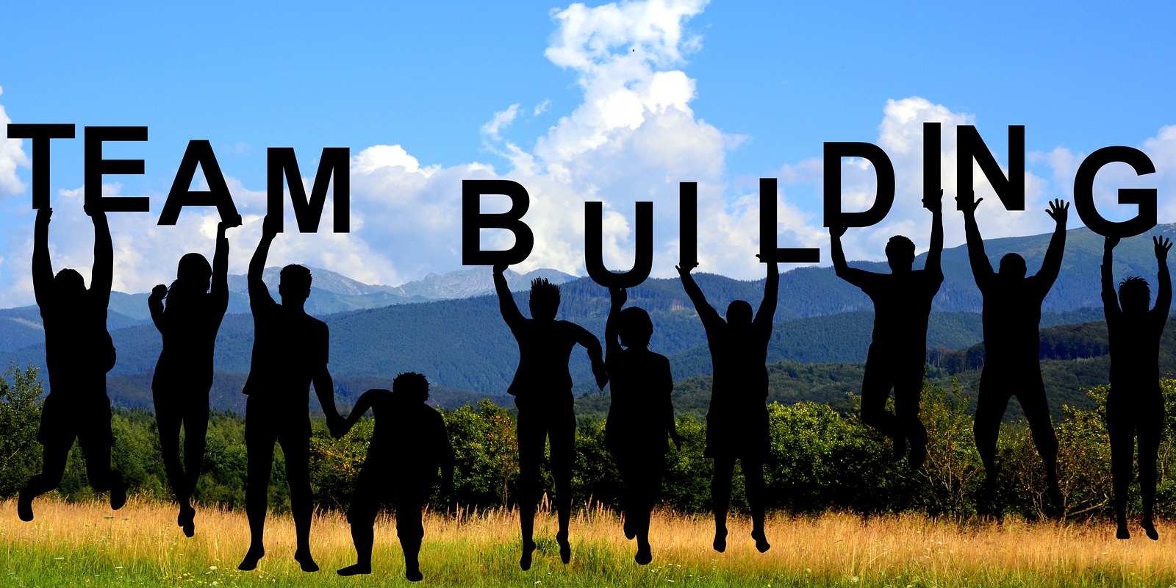
CONCLUSION
Deadlines need to be followed strictly in a team.
The aims and objectives should be understood by all team members.
People's abilities and personalities have developed as a result of working in teams.
Collaboration among team members boosts an organization's productivity.

Slide 20


